Slide 1
FLOW CONTROL
And general understanding about pumps
P4 Student Presentation
Group ED4-1-F2018 AAU Esbjerg

Slide 2
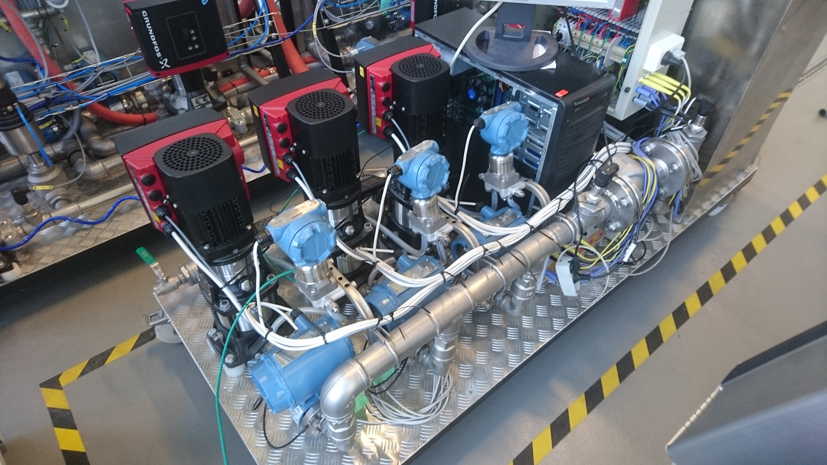
AGENDA
Troels – Introduction and data gathering
Razvan – Controller design
Daniel – Future work

Slide 3
INTRODUCTION
Why we chose to work with the pump system?
Working with an already existing system compared to building a system from the ground up.
At first we wanted to optimize the energy consumption by running 1, 2 or 3 pumps depending on what would be most efficient. (Daniel)
Changed direction - End goal was to analyse the pump-system and model it mathematically, in order to control a constant flow using a PID controller.
Notes:
We chose to work with the pump-system because we thought it would be interesting to work with something that was completely new and challenging.
The 3-pump system was already avaliable to work with, which also was a change from our previous projects were we build everything from scratch. That doesn’t mean it was any easier, because we didn’t know how anything about how it worked and it turned out there was quite a steep learning curve. (just to get to it do anything).
At first we wanted to optimize the energy consumption by selecting between running 1, 2 or 3 pumps depending on what would be most efficient.
(Daniel will present what we did in that area, after the report was handed in).
Mention we changed direction since it was a bit ambitous within the given timeframe.

Slide 4
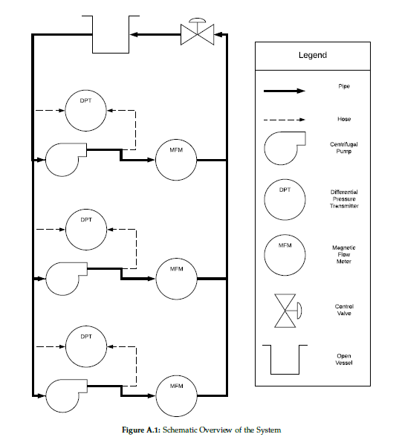
PHYSICAL SETUP SUMMARY
Schematic overview of pump system
The system’s individual parts
Controllable inputs - Individual pump speed - Control valve
Measurable outputs - Individual flow for each pump - Individual differential pressure for each pump - Individual power consumption for each pump
Notes:
The system consists an open water tank, and 3 identical centrifugal pumps in parallel, with individual sensors for measuring pressure and flow.
A control valve that can be operated to change the flow and pressure, or introduce disturbances to the system. Everything is connected together using pipes.
The controllable inputs + Measurable outputs

Slide 5
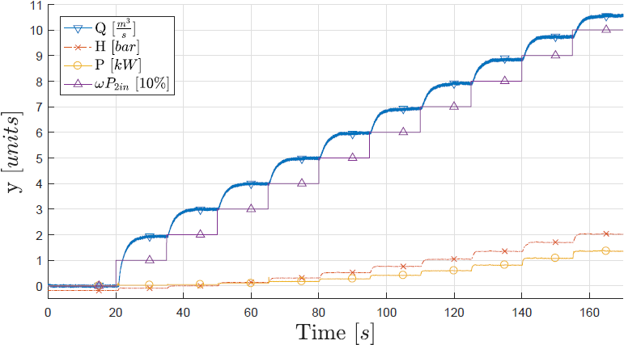
DATA GATHERING EXAMPLE
Correlation between Flow, Head, Power and Pump speed CV = 70% (Real-time view)
Analyzing how the system reacts in real-time
For gathering data we used a Simulink model and MATLAB Scripts
Example graph shows how a test was performed, with sensor data measured with control valve 70% open.
Several tests were conducted to identify the correlations between pump speed, backpressure, flow and power consumption.
Notes:
Learn how system reacts, relations between flow/pressure/pump speed etc.
To give some more insight in the testing, we wanted to show the data collected in
a single run.
While executing a run, the data for all used sensors was
shown on the target in real time.

Slide 6
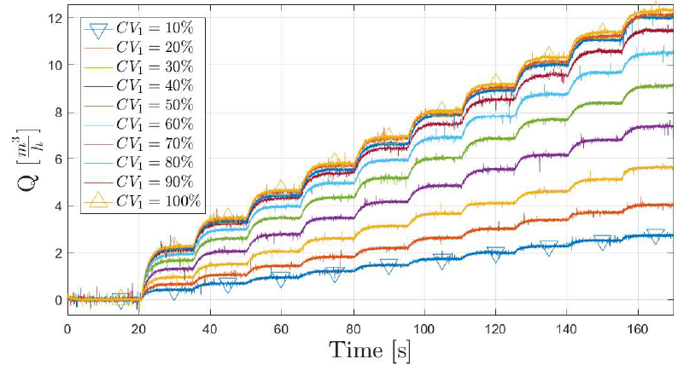
SYSTEM TEST (FLOW)
Raw flow data for control valve position 0-100% and pump speed 0-100%
Plotted toghether in one graph
To measure flow, pump speed was increased from 0-100% in 10% intervals every 15 seconds to let system stabilize.
This was done for all control valve positions in 10% intervals.
Steady-state can easily be seen.
Notes:
The following Figures shows the collected data through several
runs, each with a different CV and pump speed.
Starting from 0% pump speed (wP), we have increased wP
by 10% every 15 seconds. This was done in order to give the system some time to
stabilize. The process was repeated for a range of valve openings. Similar to wP,
the valve was in the beginning 10% open, gradually increasing by 10% and finally
reaching 100%.

Slide 7
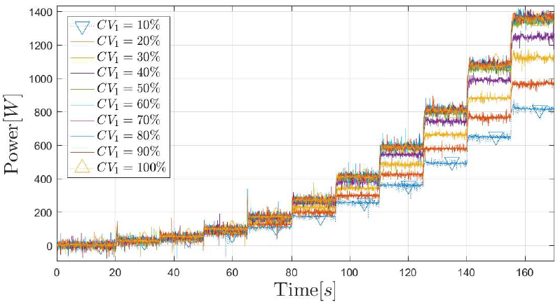
SYSTEM TEST (POWER)
Raw power data for control valve position 0-100% and pump speed 0-100% Plotted toghether in one graph
Same procedure as before, running at all different pump speeds with control valve position changed.
Steady-state can easily be seen, but more fluctuating.
Notes:
Same procedure as before, running at all different pump speeds with control valve position changed.

Slide 8
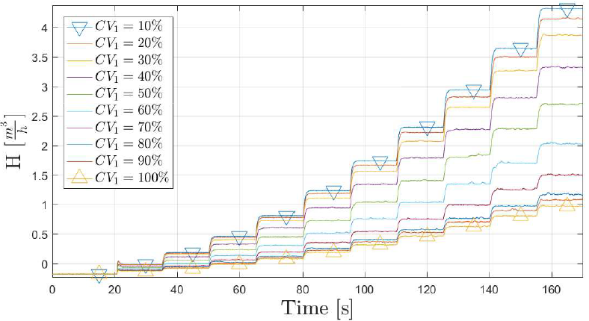
SYSTEM TEST (HEAD)
Raw head data for control valve position 0-100% and pump speed 0-100%
Same procedure as before, running at all different pump speeds with control valve position changed.
bar

Slide 9
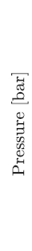
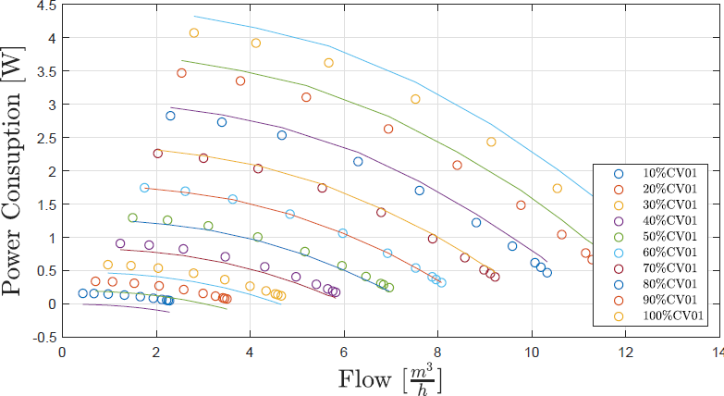
STATIC MODEL VALIDATION PUMP CURVES
Mathematical steady-state model (lines) compared to measured data (dots) for Pump curve
Pump curve validation: Comparison between our mathematical steady-state model (lines), and the actual data measured (dots).
The curve fitting is really accurate.
We are heavily filtering by taking the average over a lot of datapoints in the steadystate.
coefficients for the model were determined at 60% pump speed.
Error in report Should have been pump speed
Notes:
For the actual data we compared several runs, heavy filtering out noise by taking the average of the steady-state
Validation = Comparison between our mathematical model based on affinity laws, and the actual data measured.
The static model explains the behaviour of the system at steady-state, i.e. when
the output is settled after a step input.
Typical static models for pump systems are pump curves and system curves. (Daniel future work – 3D plots of comparing all 3 pumps and their efficency)

Slide 10
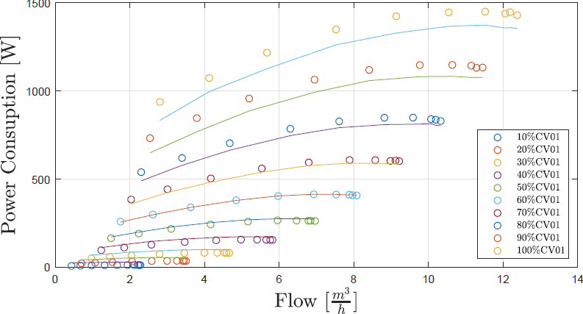
STATIC MODEL VALIDATION POWER
Mathematical steady-state model (lines) compared to measured data (dots) for Power and Flow
Again changes can be seen between the model and measured data, when moving away from the starting point (CV = 60%)
Some inaccuracy was expected, but we are not complete sure what causes this.
Error in report Should have been pump speed

